Slide 1

What’s My Inheritance?
“Something to Say” Bible Study
December 8th

Slide 2


Presenters
Rhonda Hill, Race and Faith Pastor Drew Yoos, Holy Cross
rhonda@raceandfaith.org

Slide 3
Terms to Know
Racism
White Supremacy
Anti-racism

Slide 4


Slide 5


Slide 6


Slide 7


Slide 8
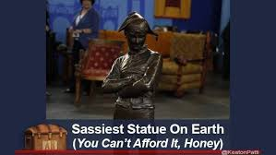
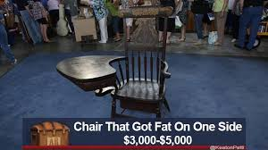

Show and Tell
Go find an item in your home that was passed onto you by another generation? Who can find the oldest item?

Slide 9
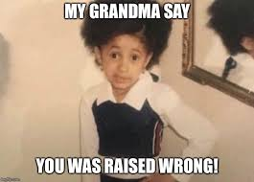
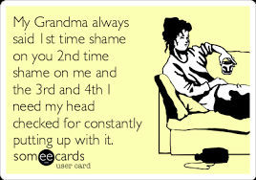
Pass it Down
What is one idea that was passed on to you by a previous generation?
(my grandma always said…)

Slide 10
Show and Tell
Go find an item that you hope to pass down one day

Slide 11
Pass it Down
What is one idea that you hope to pass down to your kids and grandkids?

Slide 12
Pass it Down
Younger generation- what stories do your parents/grandparents ALWAYS tell?
Older generation- What traditions, stories, recipes, skills etc have been passed on to you that you are now passing on?

Slide 13
Judges 2: 8-12
Joshua son of Nun, the servant of the Lord, died at the age of one hundred ten years. So they buried him within the bounds of his inheritance in Timnath-heres, in the hill country of Ephraim, north of Mount Gaash. Moreover, that whole generation was gathered to their ancestors, and another generation grew up after them, who did not know the Lord or the work that he had done for Israel. Then the Israelites did what was evil in the sight of the Lord and worshiped the Baals; and they abandoned the Lord, the God of their ancestors, who had brought them out of the land of Egypt; they followed other gods

Slide 14
What’s Your Inheritance?
What happened after Joshua died?
Why do you think that happened?
How did things get so bad in one generation?
What happens when a generation doesn’t share its stories?
All those memories, stories, are important and have helped shaped your life as a family, your faith. If you don’t share those things that make your family, family you might lose them.

Slide 15
What’s Your Inheritance?
What did you learn about God from an older generation?
What did you learn about racism from an older generation?
We have to share all the good and the bad. It seems that we have a generational gap in how we understand the danger of racial oppression. Just as passing family traditions down from generation to generation, so it goes with racism. Not talking about the ways in which you struggled with racism, how you witnessed the racial turmoil of the pass as well as the times of taking a bold stance against such oppression, is perpetuating a void of understanding about the history of race relations in this country. To change a generation, we have to talk together and listen together because the fight against racism takes all of us.

Slide 16
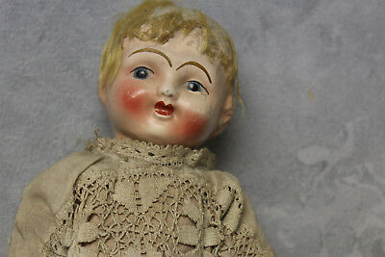
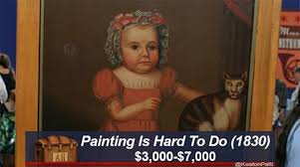
Keep or Toss?
What is a family heirloom or antique that you have thrown out?
How difficult is it to throw out a family heirloom?
What are some ideas that you have thrown out?

Slide 17
Generation to Generation
Why aren’t these conversations happening more?
Younger generation- What do you need from an older generation?
Older generation- What do you need from a younger generation?

Slide 18


SAVE THE DATE AND JOIN US!

Slide 19
https://bit.ly/SomethingtoSay_Register

