Slide 1

Comfort or Challenge?
“Something to Say” Bible Study
November 19th

Slide 2
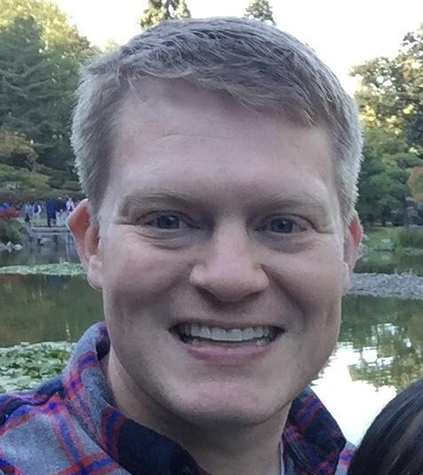
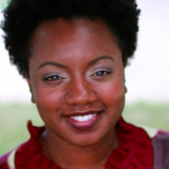
Presenters
Rhonda Hill, Race and Faith Pastor Drew Yoos, Holy Cross
rhonda@raceandfaith.org

Slide 3
Terms to Know
Racism
White Supremacy
Anti-racism

Slide 4


Slide 5


Slide 6


Slide 7

What Would You Say?
One person at a time will volunteer to answer BEFORE the statement is read
After hearing the statement, you have to respond with the FIRST thing that comes to your mind

Slide 8

What would you say if….
… someone insulted your new clothes that you were wearing for the first time?

Slide 9

What would you say if….
… someone offered you $10,000 on the spot?

Slide 10
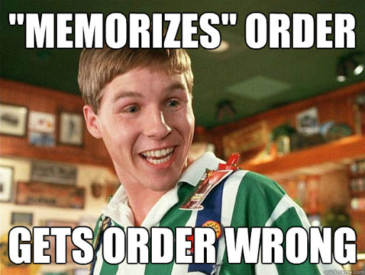
What would you say if….
… you ordered french fries but the waiter brought you a side salad instead?

Slide 11

What would you say if….
… someone invited you to their large indoor house party this weekend?

Slide 12
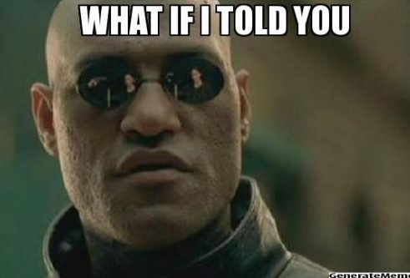
What would you say if….
… someone told you that something terrible would happen to you tomorrow?

Slide 13

What would you say if….
… someone walked up to you on the street who you did not know and claimed to be your biggest fan?

Slide 14
What would you say if….
Someone you have a relationship with told a racist joke?
Someone brought up some of the racial unrest and police incidents happening in this country?
Someone brought up a racially charged event they witnessed at your work/school?
Someone told you that there was no such thing as racism?
Our goal is to have “something to say”

Slide 15
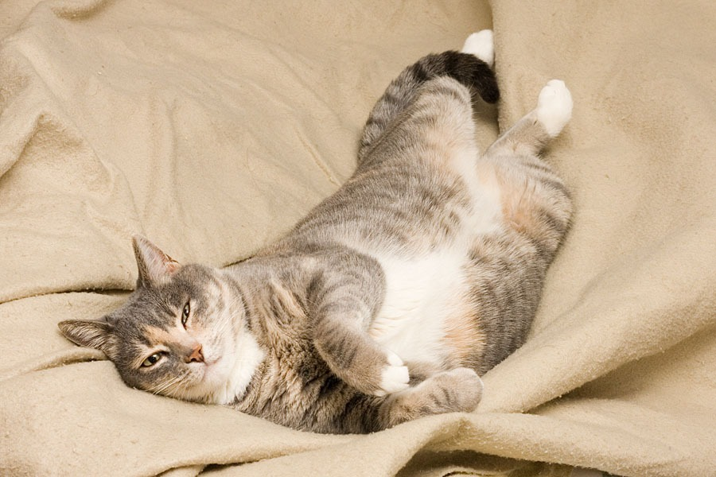
Comfort or Challenge?
What does it feel like to be very comfortable?
What is a situation where you feel totally comfortable?

Slide 16
John 8: 1-11
And Jesus went to the Mount of Olives. Early in the morning he returned to the temple. All the people gathered around him, and he sat down and taught them. The legal experts and Pharisees brought a woman caught in adultery. Placing her in the center of the group, they said to Jesus, “Teacher, this woman was caught in the act of committing adultery. In the Law, Moses commanded us to stone women like this. What do you say?” They said this to test him, because they wanted a reason to bring an accusation against him. Jesus bent down and wrote on the ground with his finger.

Slide 17
John 8: 1-11
They continued to question him, so he stood up and replied, “Whoever hasn’t sinned should throw the first stone.” Bending down again, he wrote on the ground. Those who heard him went away, one by one, beginning with the elders. Finally, only Jesus and the woman were left in the middle of the crowd.
Jesus stood up and said to her, “Woman, where are they? Is there no one to condemn you?”
She said, “No one, sir.” Jesus said, “Neither do I condemn you. Go, and from now on, don’t sin anymore.”

Slide 18
Comfort or Challenge?
Who does Jesus comfort? Who does he challenge?
How does Jesus comfort?
Is this story comfortable or challenging for you?
Name a situation where you would want Jesus to comfort you?

Slide 19

Comfort or Challenge?
What is the most challenging thing you have ever done?
What is a situation that always challenges you?

Slide 20
Mark 10: 17-23
As Jesus continued down the road, a man ran up, knelt before him, and asked, “Good Teacher, what must I do to obtain eternal life?” Jesus replied, “Why do you call me good? No one is good except the one God. ¹⁹ You know the commandments: Don’t commit murder. Don’t commit adultery. Don’t steal. Don’t give false testimony. Don’t cheat. Honor your father and mother.”
“Teacher,” he responded, “I’ve kept all of these things since I was a boy.”
Jesus looked at him carefully and loved him. He said, “You are lacking one thing. Go, sell what you own, and give the money to the poor. Then you will have treasure in heaven. And come, follow me.” But the man was dismayed at this statement and went away saddened, because he had many possessions. Looking around, Jesus said to his disciples, “It will be very hard for the wealthy to enter God’s kingdom!”

Slide 21

Comfort or Challenge?
Who does Jesus challenge?
Do you think his words here might comfort someone else?
Are these words comfortable or challenging for you?
Have you ever felt Jesus challenging you to do something uncomfortable?

Slide 22
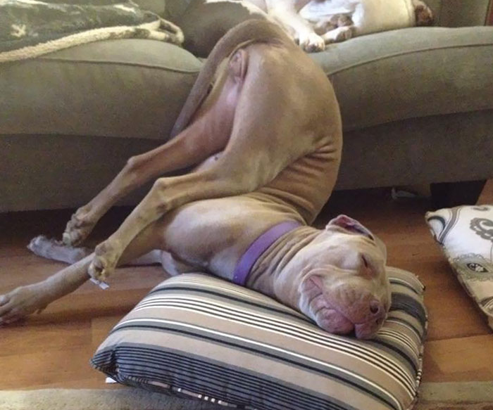
Comfort or Challenge?
Is there a part of talking about racism that makes you uncomfortable?
What parts of these conversations are comforting?
What parts are the most challenging?
Practice: find an UNCOMFORTABLE position to sit in for 30 seconds

Slide 23
Comfort or Challenge?
It’s not easy or fun to be uncomfortable and usually we prefer to stay comfortable
Jesus doesn’t just want us to be comfortable, sometimes he challenges us
Having something to say about racism and speaking up might make us uncomfortable and that’s ok
Being on the receiving end of racism is uncomfortable
White supremacy means that we have the right to comfort- to not engage in ways that make us uncomfortable
Discomfort is the start of growing
Think of a time that something started uncomfortable and gradually became more comfortable the more you did it

Slide 24


SAVE THE DATE AND JOIN US!

Slide 25
https://bit.ly/SomethingtoSay_Register

